Slide 1

Opening the Browser

Slide 2
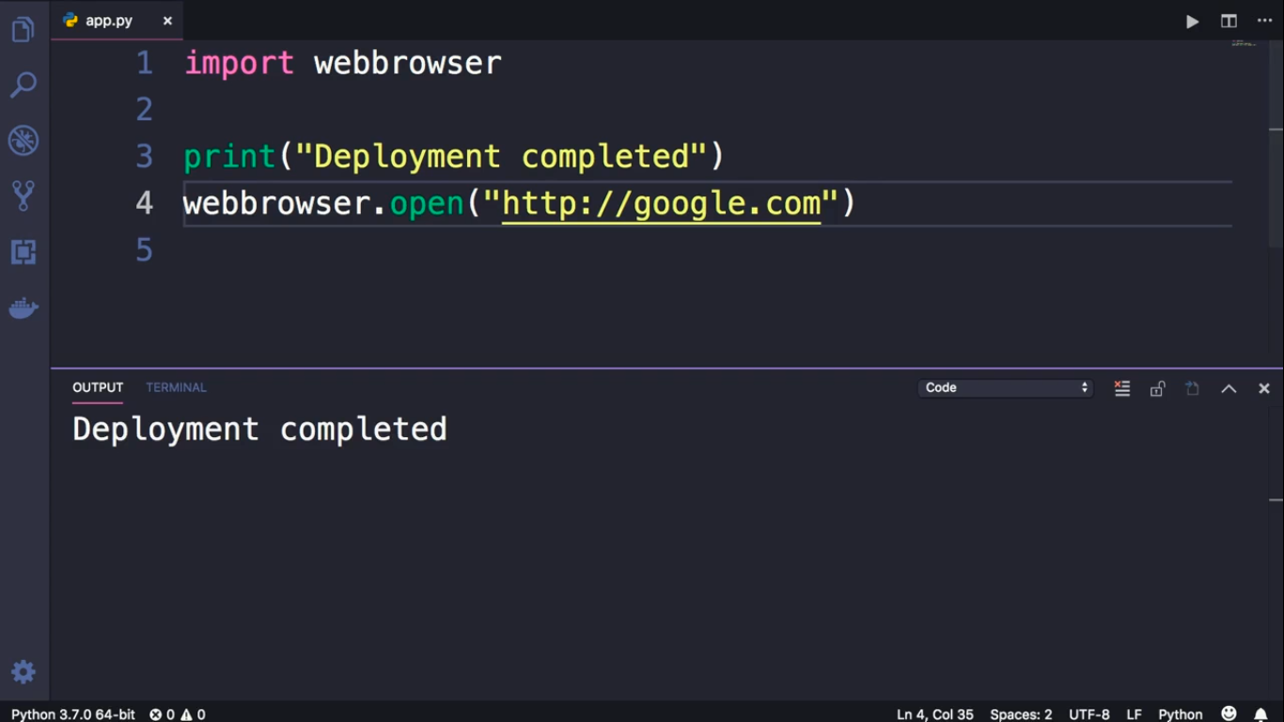

Slide 3
